Slide 1
Team radix
A Reward based Solution for ADHD/ADD children
Michelle Pradeep
Sachith Nagesh
Christy joseph anoop

Slide 2

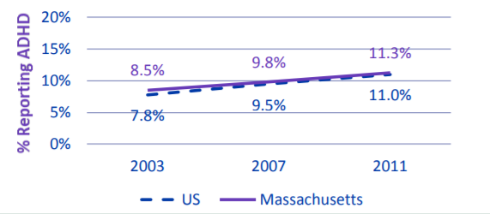
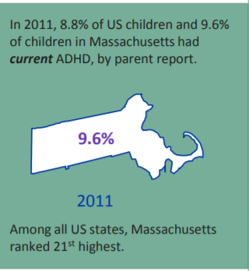
PROBLEM STATEMENT

Slide 3
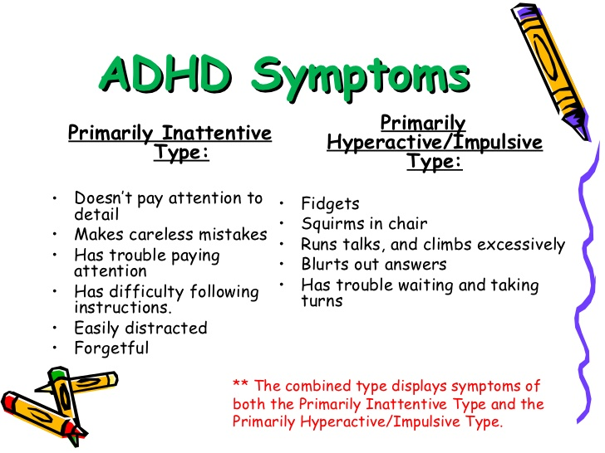

Slide 4

What happens when left untreated to adulthood?
*Source: As/Is Youtube Channel

Slide 5



Our Solution
Only focused on children from 10 – 14 yrs.
An sociotechnical ecosystem consisting of the child, parent, teacher and doctor, all working together to support the child.
Reduction in human intervention with the child.
Reduction in pill consumption.
Reward based system to analyze the progress of the child.
Carefully selected Behavioral questions for the doctor to study the child.

Slide 6
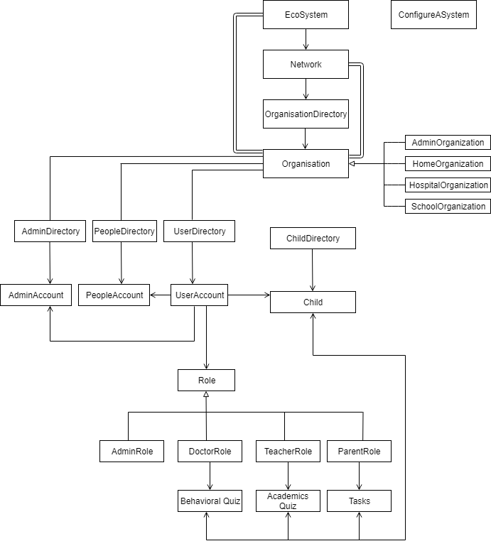
Implementation
A visit to the Northeastern Disability Resource Center (DRC) with the doctor
A Total of 59 Classes
5 External Libraries
OBJECT MODEL

Slide 7



DEMO

